Slide 1
DRIVER DROWSINESS DETECTION WITH DEEP LEARNING ON NEURAl NEtworks
Bhanu TEja NAredla
Pushkara Naga Sai Sri Vyshnavi Chakka
Vani alla
upender reddy Bokka

Slide 2
Roles and responsibilities
Each member of the team worked on multiple tasks to accomplish the project:
Finding the problem statement along with analysing requiriments and planning the project proposal was held by Upender and Bhanu Teja, while the roles of implementiation of the algorithm, training the algorithm with data and producing the required results was by Vyshnavi and Vani.

Slide 3
Motivation
The main moto of this proposal is to reduce the road accidents around us, which majorly occur due to sleepiness or lethargic conditions of a person while driving a vehicle.
To reduce the risk of crashing and detecting whether the driver is alert or drowsy, this Convolutional Neural Networks algorithm is chosen to make this more efficient.

Slide 4
Objective
In this work, the datasets containing the steering wheel frequencies and driver images will be taken into consideration.
Data in the datasets are pre-processed, to remove noisy and null values. So that the data can be analyzed and visualized for further processing.
The Convolutional Neural Networks algorithm is chosen to use three-dimensional data to for image classification and object recognition tasks.

Slide 5
Related work
To predict drowsiness, numerous works of literature have proposed different drowsiness detection systems and tools, including those that use normal cameras, Infrared (IR) cameras, and stereo cameras.
Researchers have developed various models, such as Dived et al.'s CNN-based representation feature learning approach, which achieved 78% accuracy [1].
To reduce the number of traffic injuries related to driver drowsiness, the Specialized Driver Submission algorithm was suggested to locate, map, and evaluate face and eyes to test PERCLOS in diagnosing driver drowsiness.
There are also eye-tracking-based driver drowsiness systems, such as Said et al.'s, which provide high accuracy in indoor and outdoor settings [2].
Mehta et al. developed a mobile app that can detect facial landmarks to predict driver drowsiness with an accuracy of 84% based on machine learning models.

Slide 6
Related work cont
Smart glass developed by Ellcie-Healthy incorporates a somnolence monitoring technology that provides blink detection, eye recording, and control of vital signs
The smart glass tracks these inputs and offers somnolence interference by beeping, thereby telling the driver to take a break [3].
Combination strategies involving multiple sensors on a single device, such as infrared cameras and heart rate monitors, have been shown to produce outstanding performance.
However, these tools are costly and require the setting up of proprietary solutions. While there are different approaches to detecting driver drowsiness, each with its strengths and weaknesses, it is essential to continue exploring new methods to improve the accuracy and efficiency of these systems.
By doing so, we can reduce the number of accidents related to driver drowsiness and improve overall road safety [4].

Slide 7
Problem statement
Drowsiness identification processes can be categorized based on several methods, including vehicle context, behavioral, and physiological.
Over the years, multiple methods have been developed for the identification of drowsiness.
Vehicle-based methods involve monitoring lane switches, steering wheel spin, velocity, and compressions on the accelerator pedal. Physiological signals of the driver, such as electrooculogram and electrocardiogram are monitored in physiological methods.
The existing methods of finding the Driver's Drowsiness in the driving is very difficult.
The accuracy levels of the identification of the detection are also not good.
Limitations of existing model are low performance and uses more resources.

Slide 8
Proposed system cont
The proposed methods aim to find the driver drowsiness with the convolutional neural network’s algorithm.
The accuracy levels of the identification of the driver drowsiness will be improved with the proposed system.
The deep learning on neural network will provide the better solution to solve the problem of identification of the driver drowsiness in the real-world data.
The Convolutional Neural Network algorithm will check the data in more compact with training and testing the data. It will provide more accuracy as compared with the other type of techniques.
The driver steering wheel dataset will be taken as the input to the application and the dataset will be passed into the Convolutional Neural Network algorithm and the data will be analysed with the different visual graphs.
Advantages of the proposed system are High performance, good accuracy level, increase in profit ratio, can predict the drowsiness of driver with more accuracy.

Slide 9
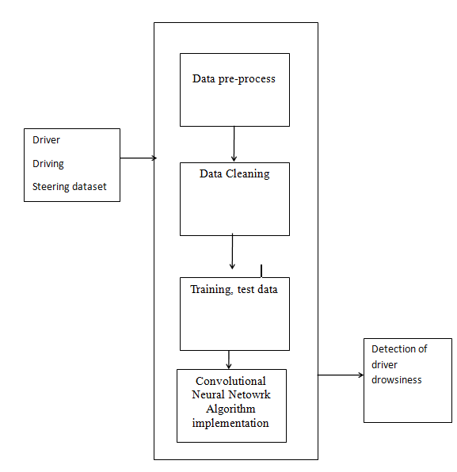
Experimental results
The work-flow of the execution process.

Slide 10
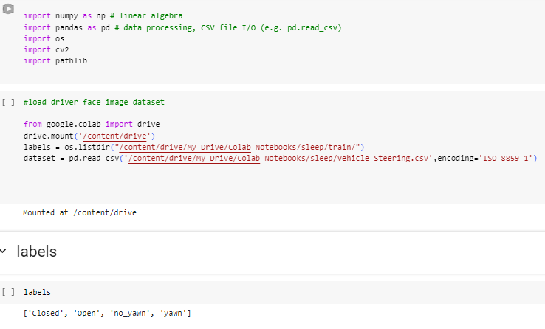
Experimental results
Load the dataset from the Google co-lab drive and mount into the application.

Slide 11
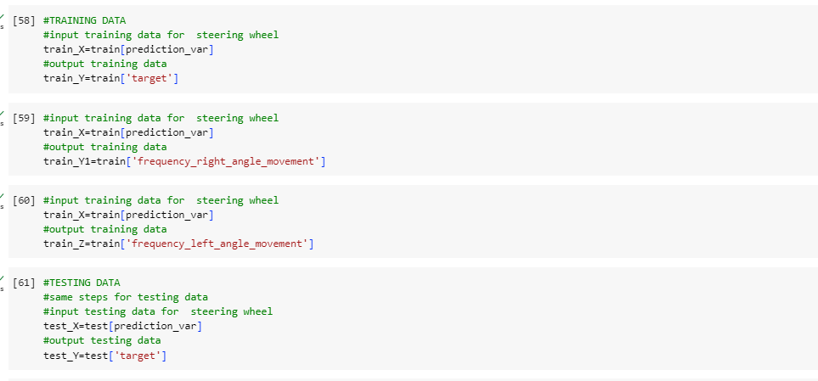
Experimental results
The image dataset is divided into testing and training to pass into the neural network model.

Slide 12
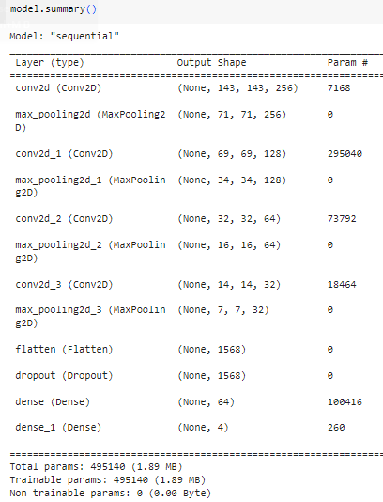
Experimental results
The Convolutional Neural Networks algorithm is applied with creating the sequential model. The output of the sequential model with layers is displayed.

Slide 13
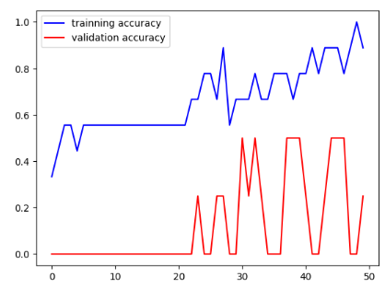
Experimental results
The final results based on the similarity and top utility items based on the profit are displayed.

Slide 14
Conclusion
The Proposed framework finds the driver drowsiness with good accuracy results.
The convolutional neural network calculations are applied to figure out the driver drowsiness from the vehicle steering dataset.
A driver monitoring system has been developed that can quickly detect drivers who are behaving sluggishly, are intoxicated, or are driving recklessly.
The Drowsiness Detection system, which is based on the driver's eye movements, can distinguish between normal eye blinks and drowsiness, and can prevent accidents caused by driver fatigue.
The system works well even when the driver wears glasses and in low light conditions, as-long-as the camera provides good output

Slide 15
references
[1] Lazebnik, S., Schmid, C., Ponce, J.: Beyond bags of features: spatial pyramid matching for recognizing natural scene categories. IEEE Comput. Society.
[2] Dwivedi, K., Biswaranjan, K., Sethi, A (2014). Drowsy driver detection using representation learning.Advance Computing Conference(IACC), IEEE,pp. 995-999
[3] Saini, V., & Saini, R. (2014). Driver drowsiness detection system and techniques: a review. International Journal of Computer Science and Information Technologies, 5(3), 4245-4249.
[4] Mandal,B.,Li,L.,Wang,G.S.,Lin,J.(2017). Towards detection of bus
driver fatigue based on robust visual analysis of eye state. IEEE Transactions on Intelligent Transportation Systems, 18(3):545557
[5] Yang, J.H., Mao, Z.H., Tijerina, L., Pilutti, T., Coughlin, J.F., Feron, E.(2009). Detection of driver fatigue caused by sleep deprivation. IEEE Transactions on Systems, Man, and Cybernetics-Part A: Systems and Humans, 39(4):694-705.
[6] Hu, S., Zheng, G. (2009). Driver drowsiness detection with eyelid related parameters by support vector machine. Expert Systems with Applications, 36(4):7651-7658.
[7] K. Fujiwara, E. Abe, K. Kamata, C. Nakayama, Y. Suzuki, T. Yamakawa, T. Hiraoka, M. Kano, Y. Sumi, F. Masuda, M. Matsuo, and H. Kadotani, „„Heart rate variability-based driver drowsiness detection and its validation with EEG,‟‟ IEEE Trans. Biomed. Eng., vol. 66, no. 6, pp. 1769–1778, Jun. 2019.
[8] C. F. P. George, „„Sleep apnea, alertness, and motor vehicle crashes,‟‟ Amer. J. Respiratory Crit. Care Med., vol. 176, no. 10, pp. 954–956, Nov. 2007.
[9] J. A. Owens, T. Dearth-Wesley, A. N. Herman, and R. C. Whitaker, „„Drowsy driving, sleep duration, and chronotype in adolescents,‟‟ J. Pediatrics, vol. 205, pp. 224–229, Feb. 2019.
[10] Mardi,Z.,Ashtiani,S.N.,Mikaili,M.(2011). EEG-based drowsiness detection for safe driving using chaotic features and statistical tests.Journal of Medical Signals And Sensors,1(2):130-137.

Slide 16
Thankyou

